Slide 1
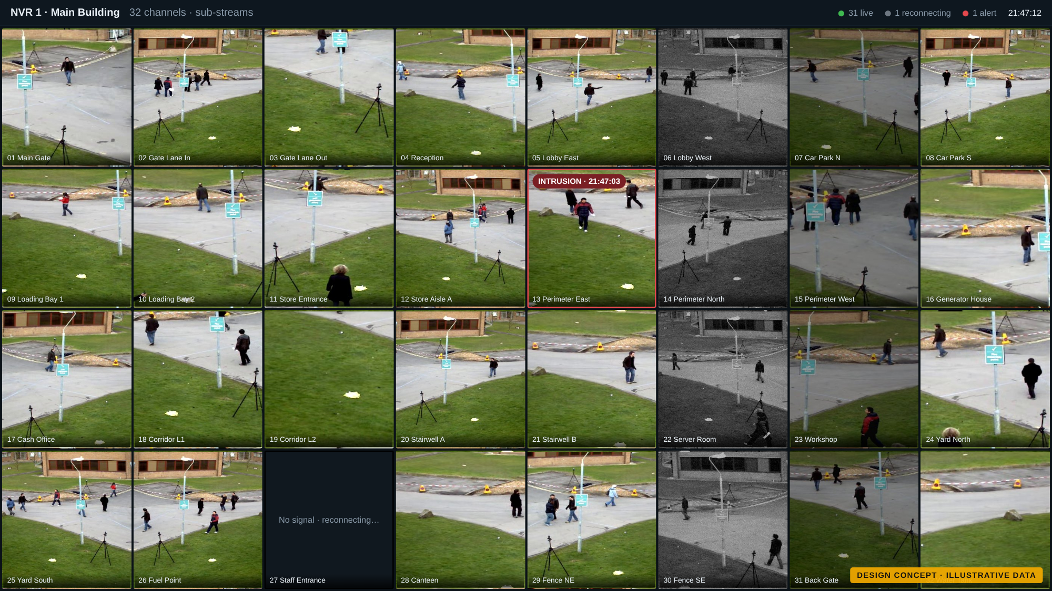
One control room for every camera
DESIGN CONCEPT
Security Surveillance System for Hikvision NVRs and cameras: solution concept
Prepared for [Client name] · November 2026
Notes:
Welcome. This is a solution concept: it shows how the finished system is intended to look and work for your sites. Every screen you will see is a design concept with sample data, not a running system. We want your feedback on it before and during delivery.

Slide 2

What you will see today
1
The challenge
What the platform must solve for your sites
2
The control room experience
About the screens in this deck
Video wall, spotlight screen, dashboard and incidents
Every screen shown is a design concept with illustrative data. It shows how the finished system is intended to look and work.
Names, numbers and camera images are samples. Details will be shaped with your team before and during delivery.
3
Detection, location and recognition
AI on every camera, geofences, GPS, face and plate
4
Reports, platform and delivery
WhatsApp reports, security, technology, roadmap, decisions
Notes:
We will go through four parts. Please keep in mind that the screens are concepts: they are there to make the ideas concrete and to collect your feedback.

Slide 3





The challenge we are solving
Geofencing
Geotagging
Theft
Breaches
Low light
Virtual boundaries that raise an alarm when crossed, on camera views and on GPS maps
Every camera, event and clip tied to a place: site, building, zone and coordinates
Loitering, object removal and after-hours activity spotted before losses grow
Intrusion, tampering and after-hours access caught as they happen
Clear night images, and warnings when a camera can no longer see
Today: 6 NVRs, 192 cameras. Planned: up to 20 NVRs and 640 cameras, a mix of ColorVu, AcuSense and non-AI cameras.
Notes:
These five problems come from your requirements. The platform also has to work with the cameras you already own, including models without built-in AI, and grow from 6 to 20 NVRs.

Slide 4

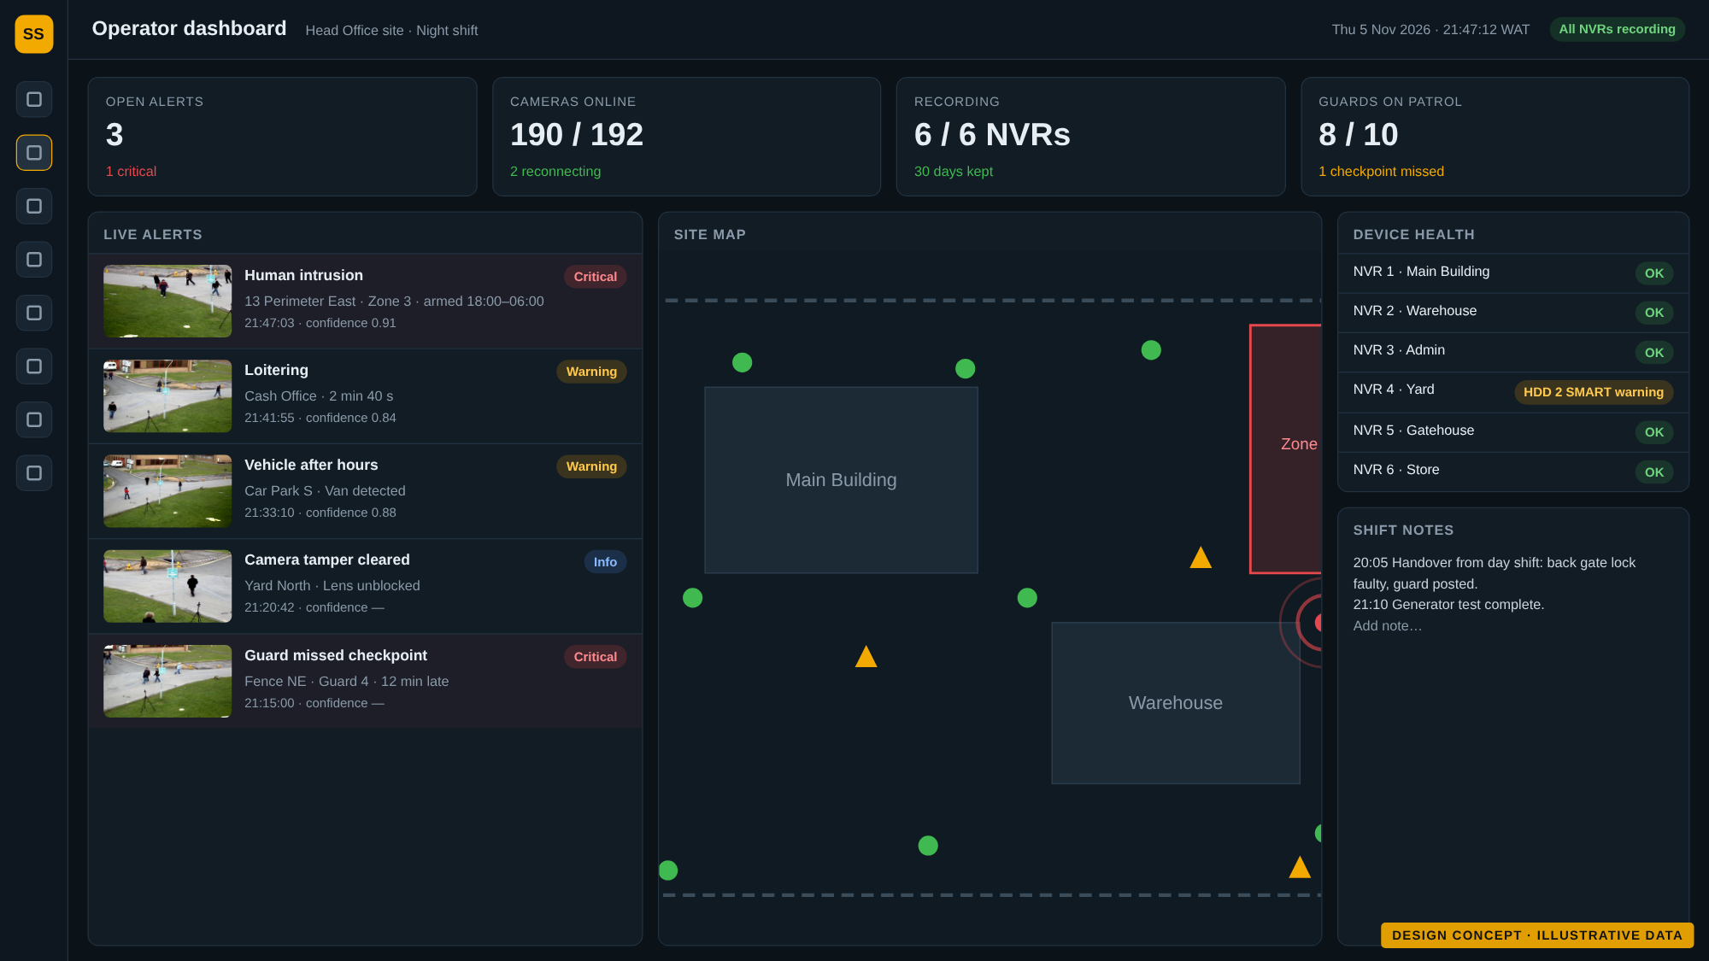



The solution at a glance
One wall for all NVRs
Every NVR on its own screen, plus a rotating spotlight of every camera
Alerts that matter
AI on every camera, rules by zone and time, severity and escalation
Knows where things happen
Site map, geofences, guards and vehicles on one map
Reports that arrive by themselves
Operator dashboard · design concept with illustrative data
Daily, weekly and monthly reports in Word and PDF, sent by WhatsApp
Notes:
In one sentence: one platform that unifies your Hikvision NVRs into a single control room, adds AI where cameras lack it, knows where everything happens, and reports automatically.

Slide 5
A live wall for every NVR
1
32 cameras per screen
One screen per NVR. Low-bandwidth sub-streams keep every tile smooth.
2
Alerts stand out
A camera with an alert gets a red frame and label at once.
3
Recovers on its own
A dropped camera reconnects by itself, and the wall PC restarts a frozen screen.
Notes:
Each NVR has its own wall screen with all 32 channels. Six NVRs means six grid screens plus the spotlight screen. The video is pulled once from each NVR and shared, so the NVRs are not overloaded.

Slide 6
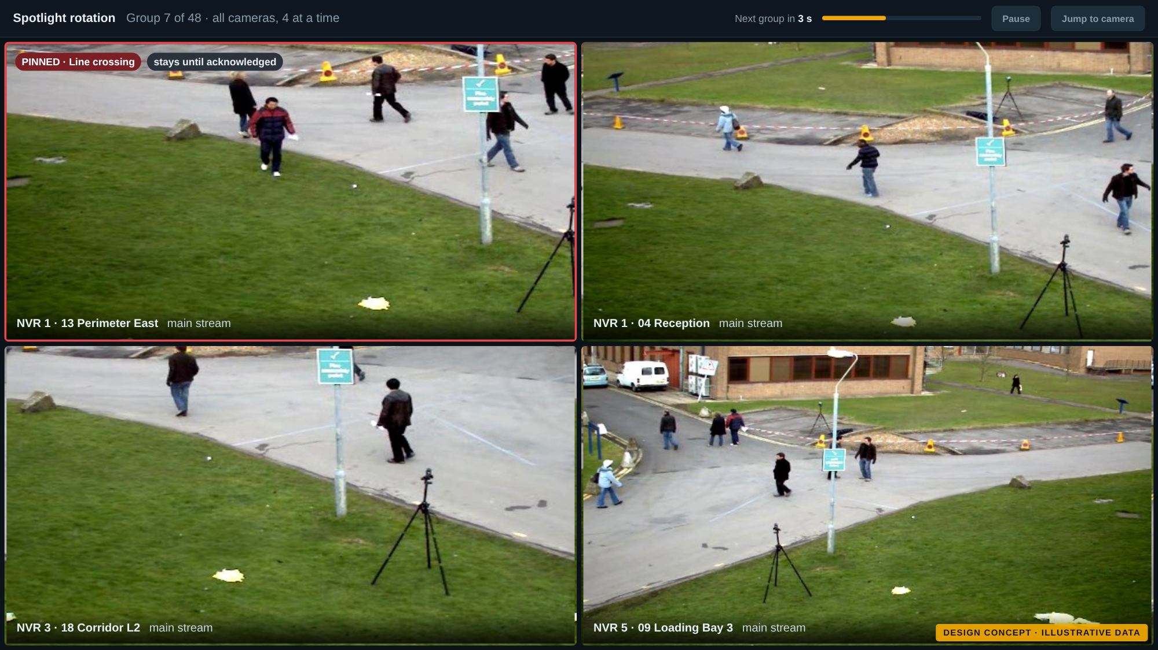
Spotlight rotation: every camera, four at a time
1
4 cameras, 5 seconds
Loops through all cameras. Group size and timing can be changed.
2
Alerts jump the queue
A camera with an alert is pinned until someone acknowledges it.
3
No black frames
The next group is connected before the switch, so changes are seamless.
Notes:
The spotlight screen shows full-quality video from four cameras at a time and moves on every five seconds. Operators can pause, jump to a camera, and alerts are pinned.

Slide 7
Operator dashboard: the shift at a glance
1
Live alert feed
Snapshot, camera, zone, time and confidence for every alert, newest first.
2
Map and device health
See where alerts are, and whether every NVR is recording.
3
Shift handover
Notes and a logbook carry over from one shift to the next.
Notes:
This is the operator's main screen. Numbers on it are samples. Two clicks take the operator from any alert to its footage.

Slide 8
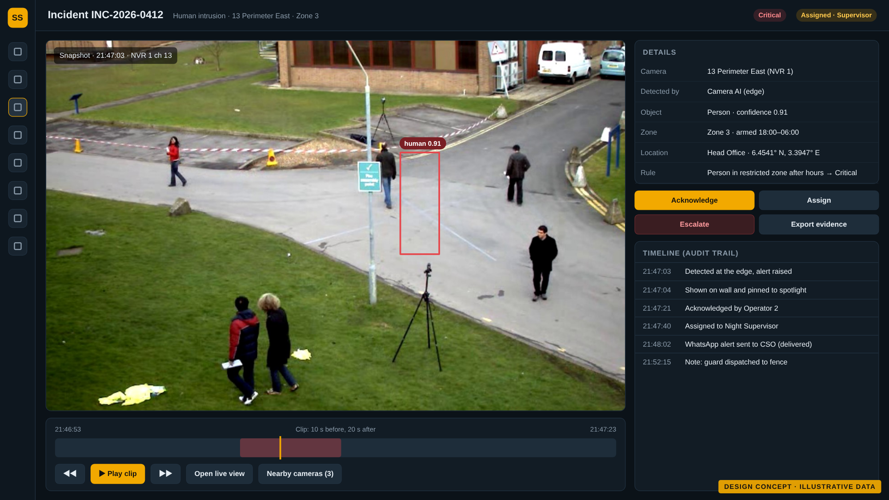
From alert to evidence in two clicks
1
Alert appears
On the wall, on the dashboard and, if critical, on WhatsApp.
2
Open the incident
Snapshot, a clip from 10 s before to 20 s after, and nearby cameras.
3
Act and record
Acknowledge, assign, escalate. Every step is logged; evidence is exported with a checksum.
Notes:
Every alert becomes a record with a full audit trail. Unacknowledged critical alerts escalate automatically to the next contact. Evidence clips are copied from the NVR so they survive the 30-day overwrite.

Slide 9



Smart detection: edge first, server assisted
Camera AI
NVR AI
Server AI
AcuSense cameras
AI-capable NVRs
Non-AI cameras
The camera tells people and vehicles apart itself. Lowest cost and fastest.
The NVR analyses a limited number of non-AI cameras.
Open-source AI on NVIDIA GPUs analyses the remaining cameras, about 5 frames per second each.
Typical alerts
Line crossing, intrusion, loitering, tamper
Typical alerts
Perimeter and motion with person and vehicle filter
Typical alerts
People and vehicles in zones, by schedule
Same alerts whatever the camera.
All three produce the same alerts, rules and reports. Each camera is placed automatically and an administrator can change it. Every camera also gets image checks: video loss, frozen image, blocked lens, too dark at night.
Notes:
Your site mixes AcuSense, ColorVu and non-AI cameras. We use the AI already inside the cameras and NVRs wherever it exists, and add our own server AI only where it is missing. This keeps cost down and coverage complete.

Slide 10
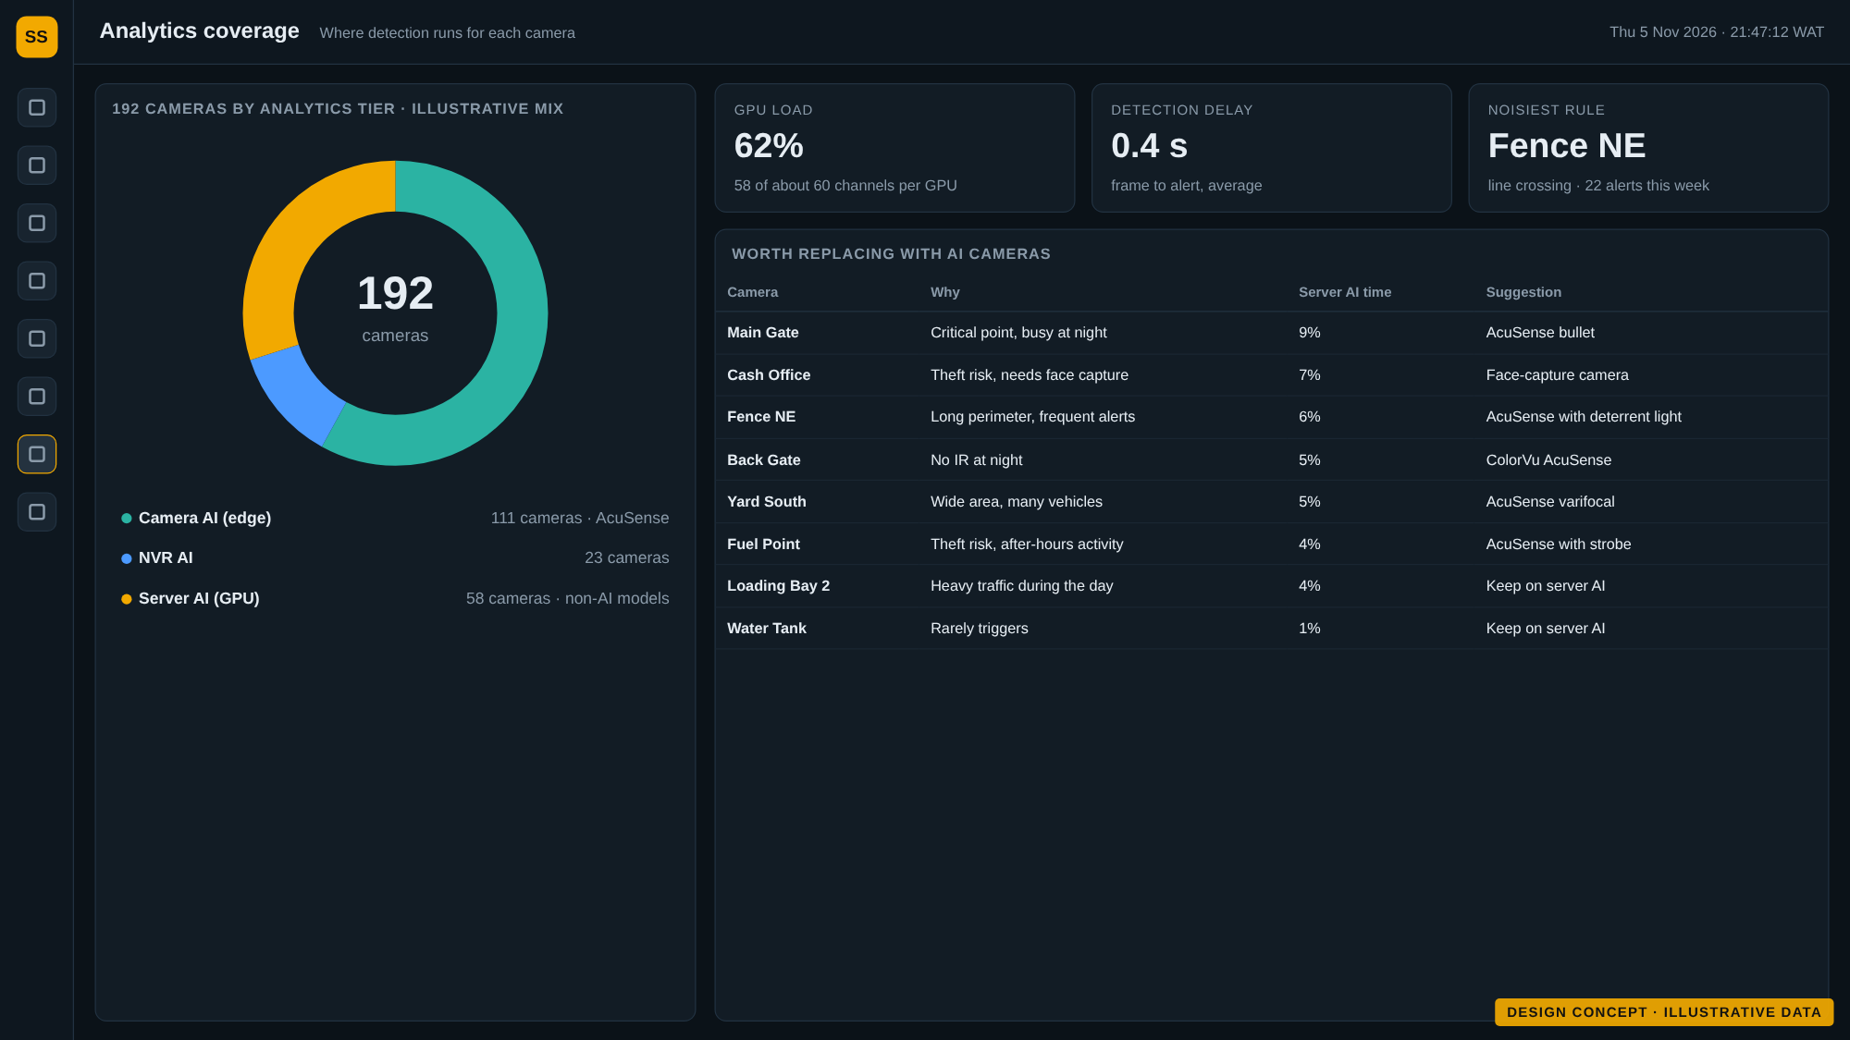
Analytics coverage: where detection runs
1
See where AI runs
Every camera's analytics tier at a glance, with the server AI load.
2
Plan upgrades with data
Critical cameras that rely on server AI are flagged as candidates for AI models.
3
Sized before purchase
About 60 cameras per GPU at 5 frames per second, confirmed by benchmark first.
Notes:
The tier mix shown is illustrative. The real mix comes from the discovery scan of your NVRs. The cost rule: compare another GPU with replacing the most critical non-AI cameras.

Slide 11
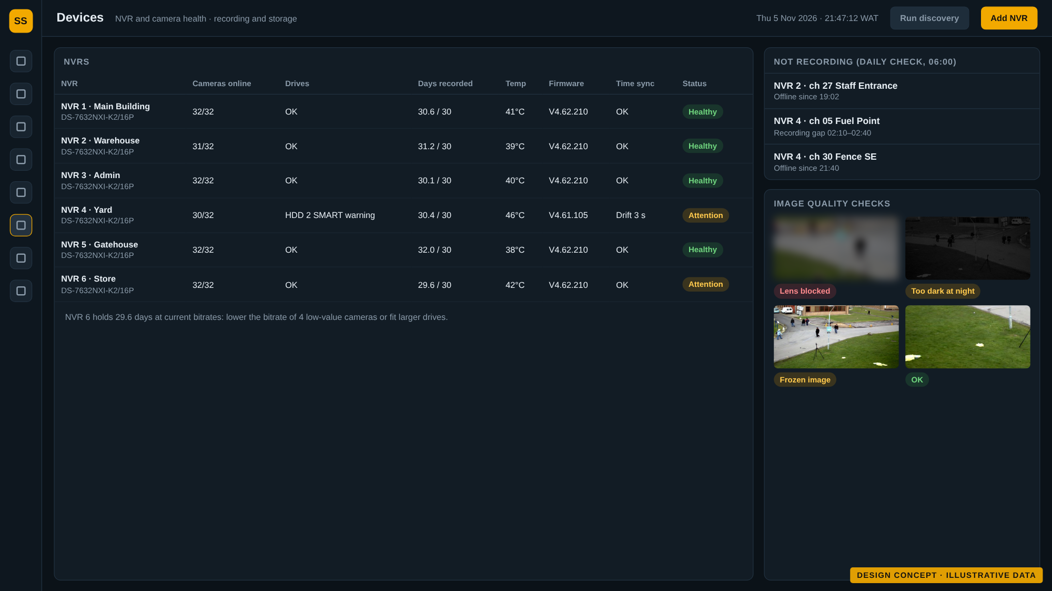
Recording and device health, checked every day
1
30 days, verified
Each NVR's recorded days, drive health and recording gaps are checked every morning.
2
Warnings before failures
Drive warnings, high temperature and clock drift raise alerts to IT.
3
Night vision checks
Cameras that are blocked, frozen or too dark at night are flagged.
Notes:
Video stays on the NVRs for 30 days. The platform proves it every day rather than assuming it, and warns IT before retention is at risk.

Slide 12
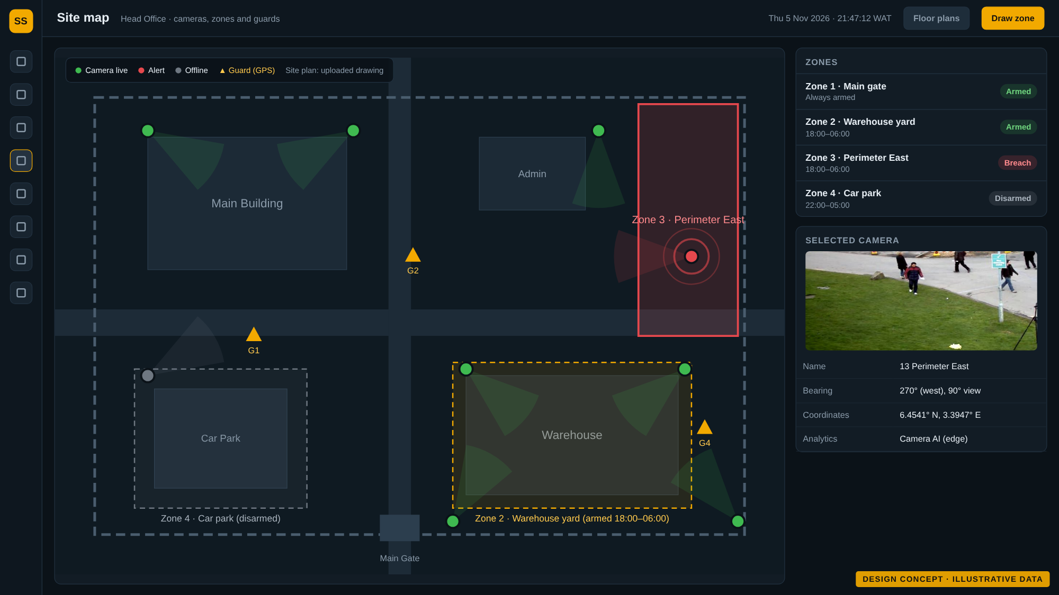
Geofencing and geotagging on the site map
1
Draw zones once
Zones are pushed to cameras that support them; server AI covers the rest.
2
Zones with schedules
Arm a zone from 18:00 to 06:00, or around the clock.
3
Everything has a place
Cameras show position and viewing direction; every event carries its location.
Notes:
Camera zones and GPS zones live in one place and use one rule engine. Maps use OpenStreetMap data hosted on site, with your floor plans as images.

Slide 13
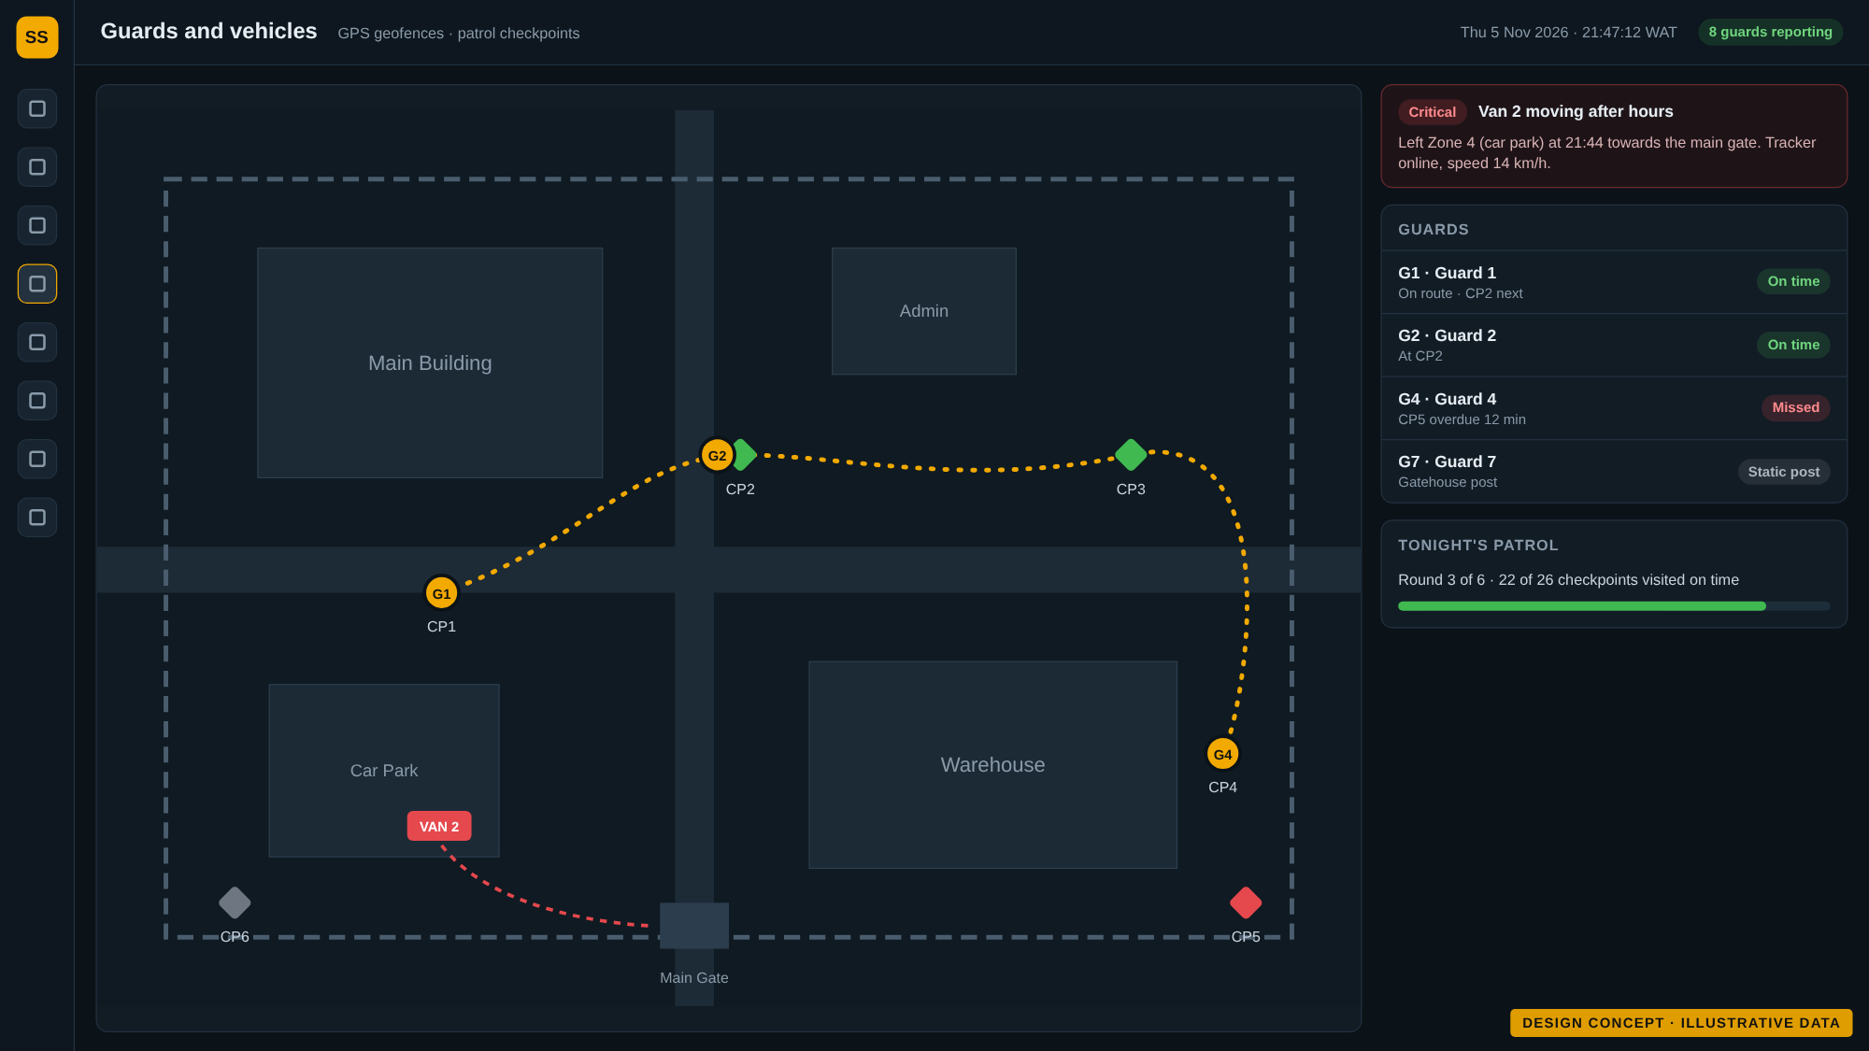
Guards and vehicles on the same map
1
Open-standard GPS
Guard phones (Android) and vehicle trackers report to Traccar, an open-source GPS server.
2
Patrol checkpoints
A missed or late checkpoint raises an alert to the supervisor.
3
One rule engine
GPS zones and camera zones share the same alerts and reports.
Notes:
We start with 10 Android guard phones. Vehicle trackers will be chosen among models with open protocols, so there is no vendor cloud.

Slide 14
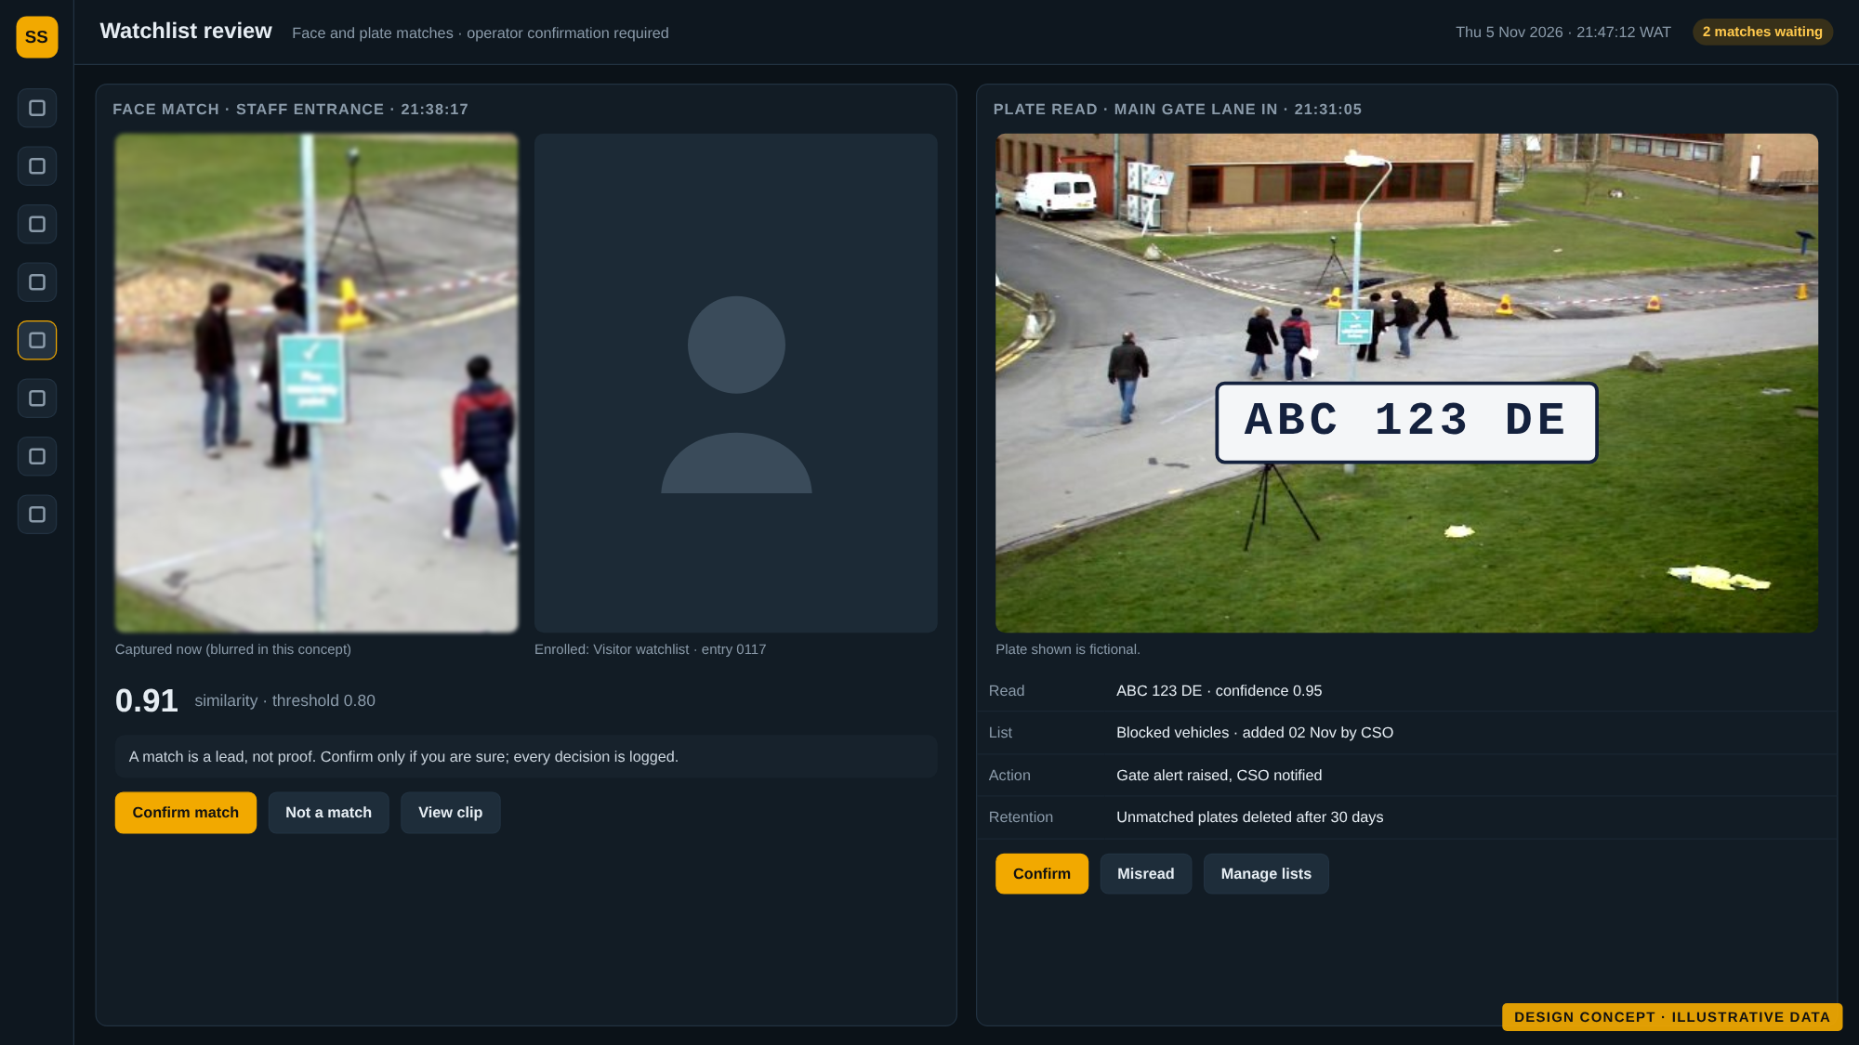




Face and plate recognition, with safeguards
Watchlists only
Matches against enrolled lists. No identification of everyone.
A person decides
A match is a lead; an operator confirms it, and every review is logged.
Camera by camera
Recognition runs where a camera sees faces or plates clearly enough.
Legal gate first
Impact assessment, signage, retention limits and your written sign-off before go-live (Nigeria Data Protection Act 2023).
Notes:
Recognition is the most sensitive feature. It is a controlled module with its own approval gate. The legal review can take longer than the software, so we propose to start it now. Accuracy will be measured on your own footage, day and night, before go-live.

Slide 15
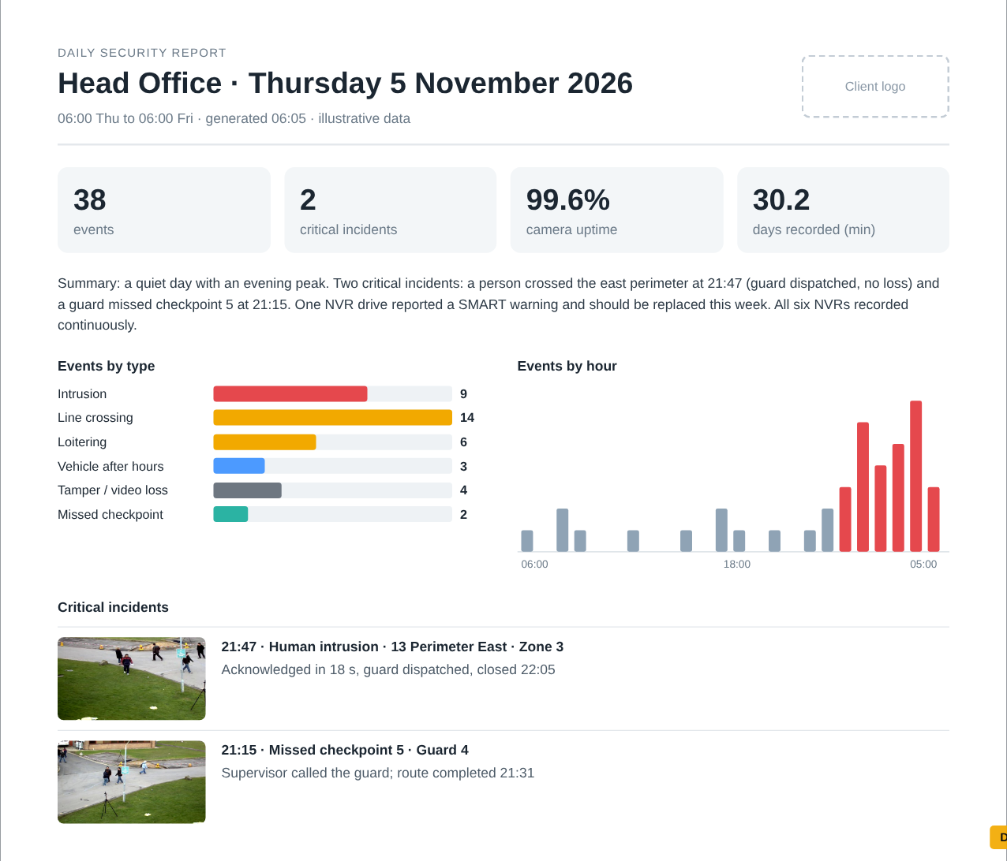
Reports that write themselves
Daily
Event totals, critical incidents with snapshots, camera and NVR health, open items
Weekly
Trends against last week, top places and times, repeat alerts, uptime, actions
Monthly
Executive summary, charts, month on month, incident register, recommendations
Word and PDF, with your logo and colours
Sent on schedule, or generated on demand for any period, site or camera
Archived and searchable in the platform
Daily report · design concept with illustrative data
Notes:
Reports combine a plain-language summary with charts and tables. Templates are branded and editable. Report language and timezone can be chosen per client.

Slide 16
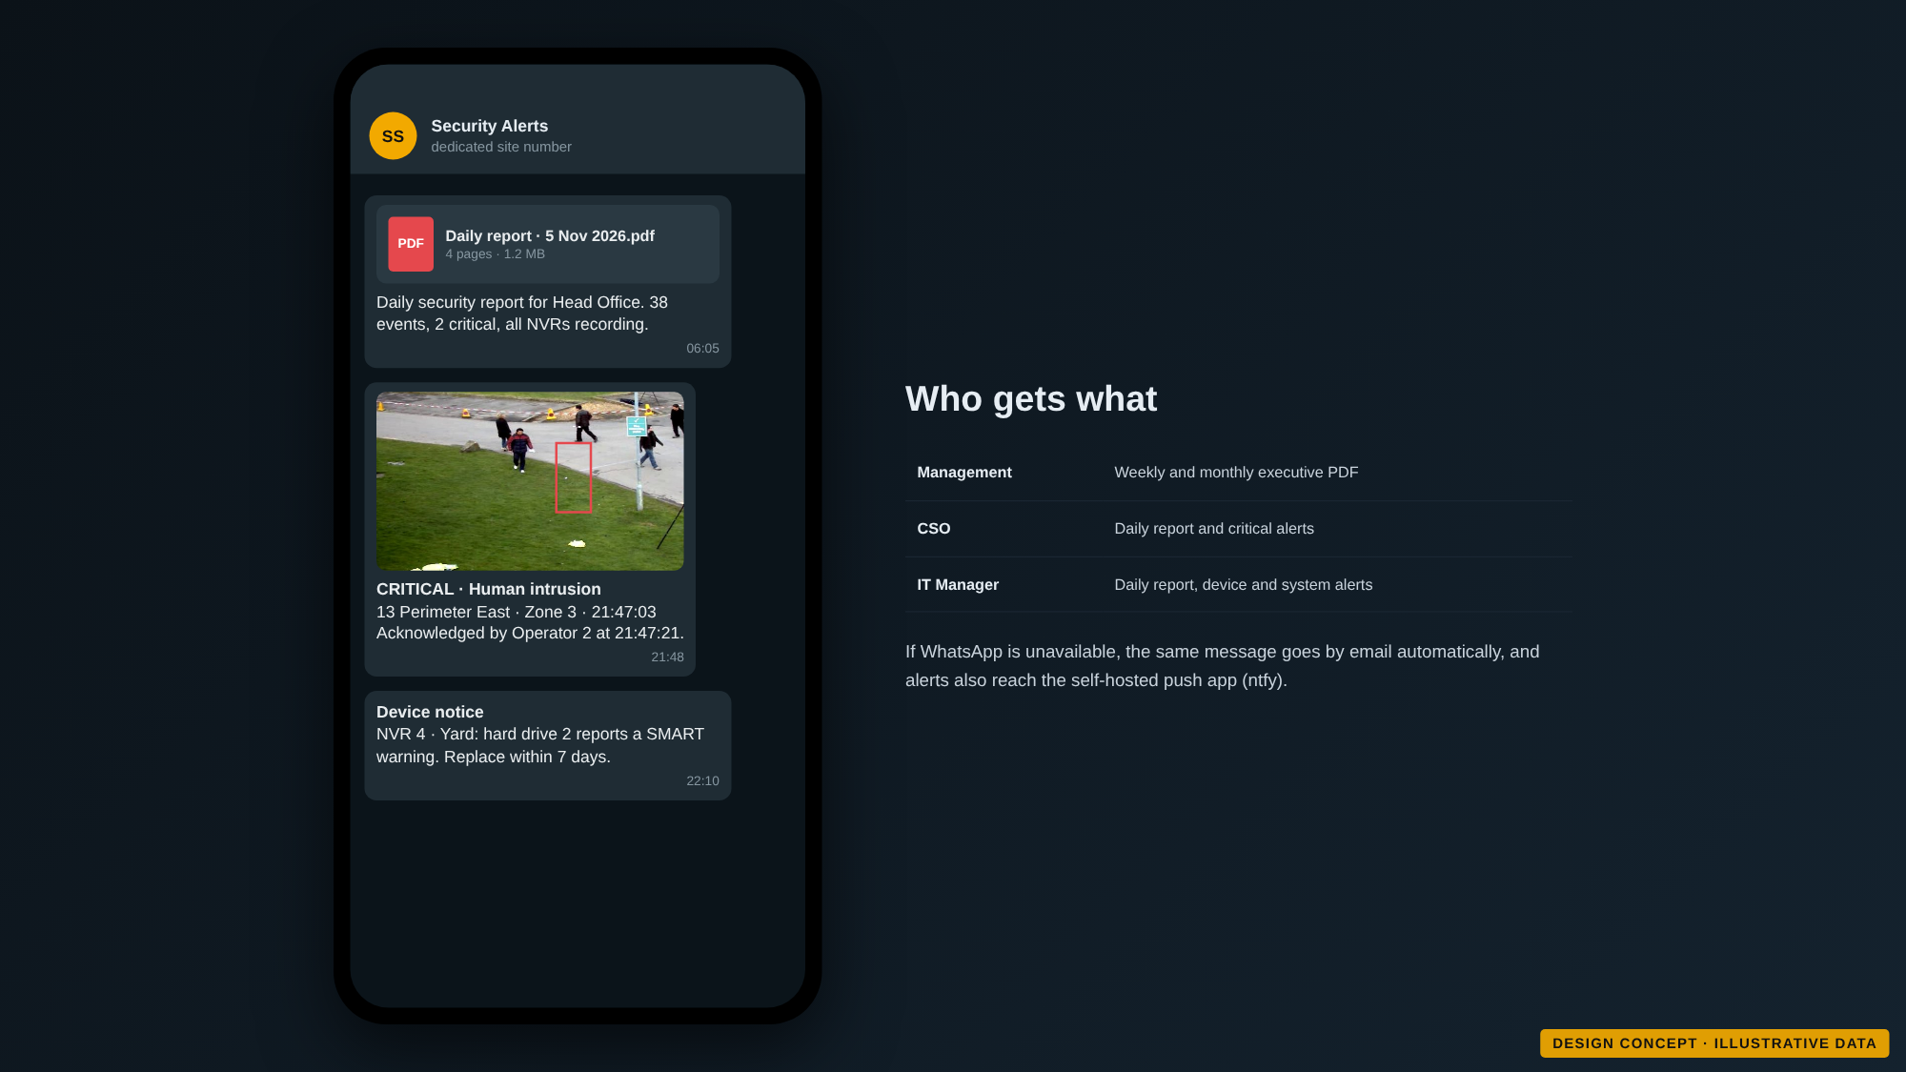
Delivered to the people who need it
1
WhatsApp first
Reports and critical alerts reach Management, the CSO and the IT Manager from a dedicated number.
2
Never missed
If WhatsApp is unavailable, email and push notifications take over automatically.
3
Targeted delivery
Subscriptions by role, site and report type, with opt-in records.
Notes:
WhatsApp goes through a free self-hosted gateway on a dedicated number, with low volume and automatic email fallback. The official paid WhatsApp Business service can be enabled later if you prefer.

Slide 17
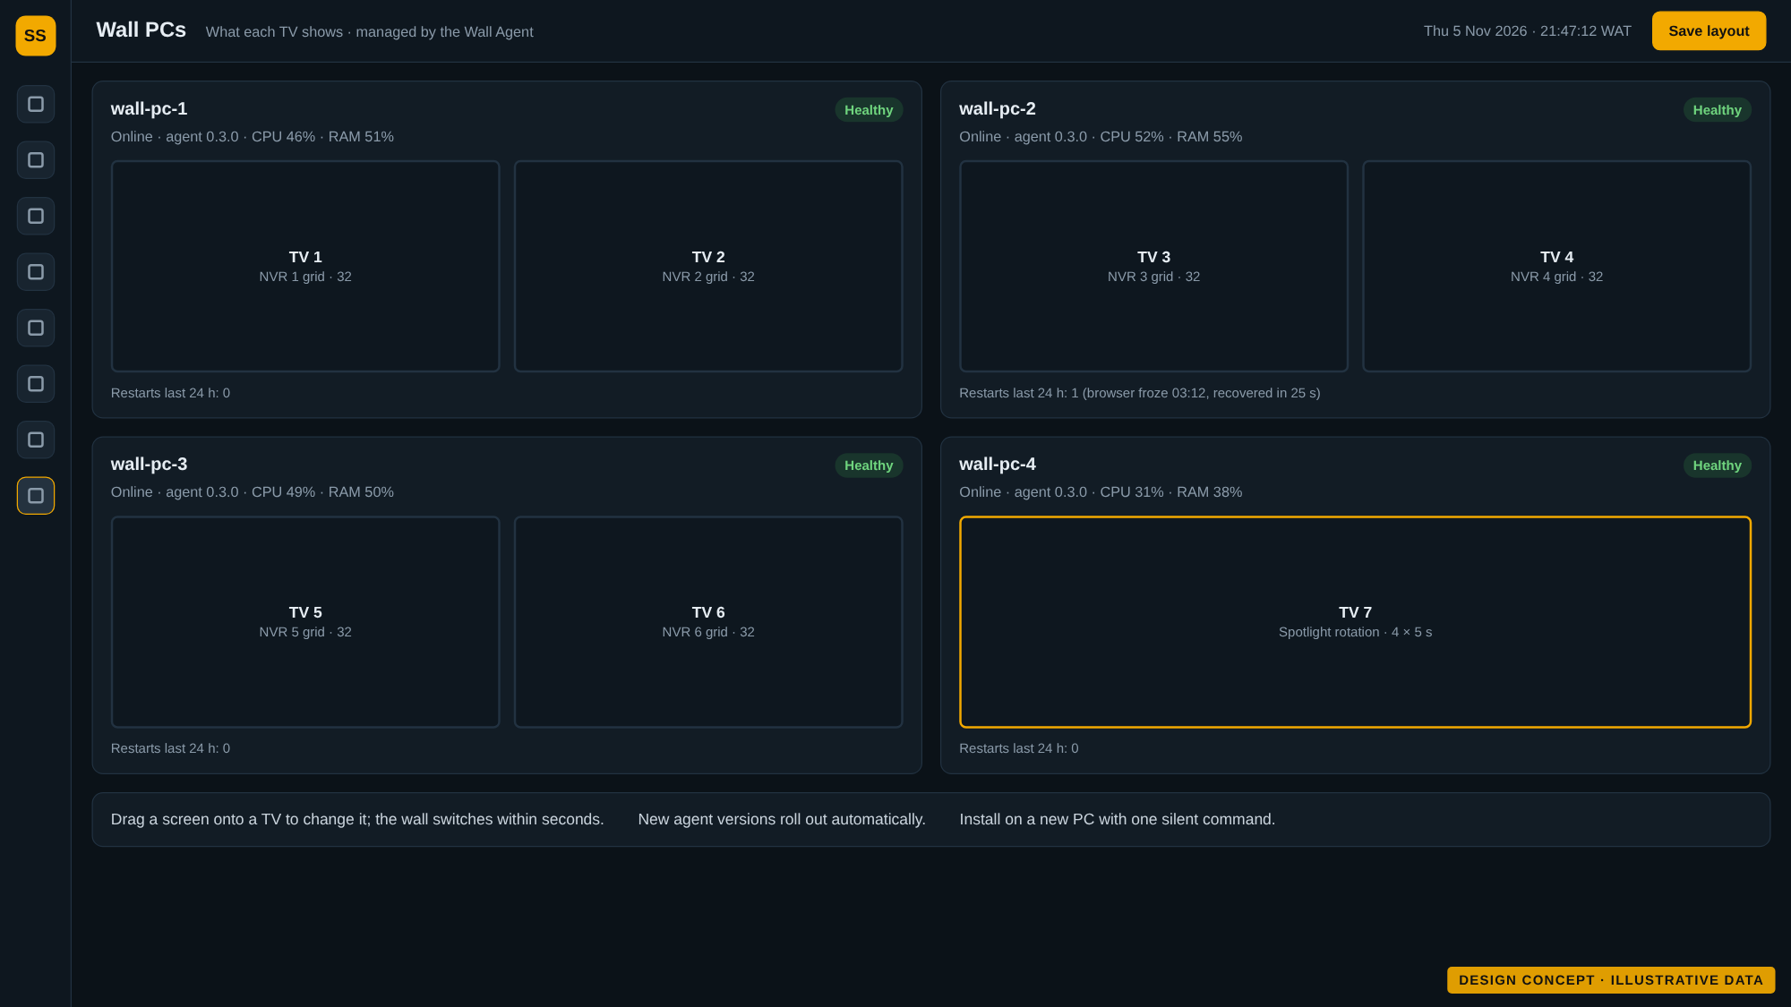
Wall PCs that look after themselves
1
Assign screens centrally
Choose what each TV shows from the platform; the wall follows within seconds.
2
Recovers on its own
Crashed or frozen screens restart by themselves, and the wall comes back after a power cut.
3
Easy to roll out
One installer with a silent option, and automatic updates.
Notes:
A small agent on each wall PC opens the screens in kiosk mode, watches them, reports health and updates itself. It works on Windows and Linux wall PCs.

Slide 18
How it fits together
Your devices
Platform (on your server)
People and outputs
Hikvision NVRs (6 to 20)
Device connection: ISAPI, ONVIF, RTSP
Video wall and spotlight
AcuSense and ColorVu cameras
Stream gateway: each camera pulled once
Operator web and mobile
Non-AI cameras
Events, rules, incidents and evidence
WhatsApp, email, push
GPS phones and trackers
Server AI workers on NVIDIA GPUs
Word and PDF reports
Alarm inputs and sirens
Reports, notifications, users and audit
API for other systems
Edge first: AI inside cameras and NVRs is used wherever it exists; the server adds it where it is missing. Video stays on the NVRs; the platform keeps events, evidence clips and reports.
Notes:
The platform talks to devices directly, without HikCentral or Hik-Connect. It runs on a Linux server on your premises, or hosted, with a site connector. Everything shares one event format, so alerts, rules and reports work the same for every camera.

Slide 19





Security, privacy and compliance by design
Role-based access
Two-factor sign-in
Admin, supervisor, operator, viewer and client read-only, per site and per camera
Strong passwords, second factor and session timeouts
Full audit trail
Privacy masking
Who viewed, exported, changed or deleted what, and when
Masked areas and restricted camera lists
Encrypted and separated
Retention you control
Encrypted links and stored passwords, cameras on an isolated network
30 days of video, longer for evidence, with policy reports
Notes:
Security is built in from the first release. Device passwords are never stored in plain text, default Hikvision passwords are changed during onboarding, and cameras are never exposed to the internet.

Slide 20
Open technology, no licence lock-in
No software licence to buy for the platform
Instead of | We use
HikCentral and Hik-Connect | Direct device connections (ISAPI, ONVIF, RTSP)
Paid map services | OpenStreetMap maps hosted on site
SMS gateways | Email and self-hosted push notifications
Paid or non-commercial AI models | Open models: YOLOX, OpenCV face models, PaddleOCR
Licensed server software | Linux server with Docker or Podman
Free and open-source software throughout
Works with the Hikvision devices you already own
No dependency on a single vendor's platform
Declared exceptions: your Hikvision devices, WhatsApp itself, NVIDIA drivers (free to use), and Windows that comes with the wall PCs. Hardware is bought as usual.
Notes:
Every component is free and open source, checked and recorded in a software bill of materials at each release. Where something proprietary is unavoidable, it is declared up front.

Slide 21
Built to grow from 6 to 20 NVRs
7 → 21
wall screens, about one wall PC per two TVs
< 3 s
target from detection to alert on screen
99.5%
platform availability target
Notes:
The design target is 20 NVRs and 640 cameras across several sites without redesign. Server and GPU sizing is confirmed by benchmark before purchase.

Slide 22
Roadmap: delivered in stages
Discovery and proof of concept
Release 1.0 · Must have
Release 1.1 · Should have
Release 2.0 · Could have
Inventory of every NVR and camera, tests on your real devices, wall PC and AI benchmarks
Video wall and spotlight, alerts and incidents, maps and zones, AI for non-AI cameras, reports by WhatsApp, security and backups
Face and plate recognition (after the legal gate), GPS guards and vehicles, evidence vault, PTZ, smart search, onboarding wizard
Anomaly detection, cross-camera tracking, heat maps, access control integration, mobile app, more languages
Gate: Go or no-go, requirements sign-off
Gate: First client pilot and acceptance
Gate: Accuracy results and legal sign-off
Gate: Prioritised with you
Notes:
Each stage ends with a review point with you. Release 1.0 is what the first go-live needs; recognition follows once accuracy is proven on your footage and the legal review is complete. Dates will be agreed after discovery.

Slide 23
What we need from you
1
NVR storage
2
Recognition scope
Agree the drive set-up that keeps 30 days on every NVR
Which entrances and cameras should run face and plate recognition
3
WhatsApp
4
Legal review
A dedicated number, recipient numbers and preferred send times
A lawyer or data protection officer for the biometric review
5
Wall hardware
6
Branding
Confirm wall PCs and TVs, and whether a fourth wall PC is needed
Logo, colours and report language
7
Hosting
On-premises only, or also a hosted option, and the provider
Notes:
These inputs unblock the next stage. The legal review and the WhatsApp number take the longest, so we suggest starting them first.

Slide 24
Next steps
Your feedback on this concept shapes what we build
1
Review this concept
2
Start the long-lead items
3
Run discovery on site
Tell us what to change, add or drop
WhatsApp number, legal review, hardware details
Scan every NVR and camera, then agree the release 1.0 plan
Thank you · Questions and discussion
Notes:
Close by agreeing who owns each input and when we meet next.

Slide 25
Appendix: technology stack
Layer | Components | Licence
Server | Debian or Ubuntu Server LTS, Docker Engine or Podman | Free software, Apache 2.0
Database | PostgreSQL with PostGIS | PostgreSQL, GPL (separate service)
Backend | Python, FastAPI | PSF, MIT
Video | MediaMTX or go2rtc, FFmpeg (LGPL build) | MIT, LGPL
AI | ONNX Runtime with TensorRT on NVIDIA (OpenVINO on Intel), YOLOX or RT-DETR | MIT, Apache 2.0; NVIDIA free to use
Recognition | OpenCV YuNet and SFace, PaddleOCR | MIT, Apache 2.0
GPS and maps | Traccar, Leaflet or MapLibre, OpenStreetMap tiles hosted on site | Apache 2.0, BSD, ODbL data
Reports and alerts | WeasyPrint, python-docx, email, ntfy, WhatsApp gateway | BSD, MIT, Apache 2.0
Wall PCs | Wall Agent with Windows installer (NSIS), Chromium kiosk | Our code, zlib, BSD-style
Notes:
For the technical team: the approved open-source stack. Every new component is licence-checked and listed in the software bill of materials.

Slide 26
Appendix: recommended server sizing
 | 6 NVRs · 192 cameras | 10 NVRs · 320 cameras | 20 NVRs · 640 cameras
Layout | One server | One server, second GPU as needed | Core node, 2 to 3 AI nodes, database node
CPU | 12 to 16 cores | 24 to 32 cores | 16 to 24 cores per node
Memory | 64 GB (ECC preferred) | 128 GB | 64 to 128 GB per node
GPU | 1 × NVIDIA 16 GB class | 1 to 2 × NVIDIA 16 to 24 GB class | 1 GPU per AI node
System disks | 2 × 1 TB NVMe, mirrored | 2 × 2 TB NVMe, mirrored | 2 × 2 TB NVMe, mirrored (database)
Evidence storage | 8 TB usable | 16 TB usable | 32 TB or more usable
Network | 1 GbE minimum, 10 GbE recommended | 10 GbE | 10 GbE, 25 GbE core
Wall PCs | 4 PCs for 7 screens | 6 PCs for 11 screens | 11 PCs for 21 screens
Indicative. Confirmed by benchmark on your cameras before purchase. Uninterruptible power supplies with clean shutdown for the server, wall PCs and NVRs.
Notes:
These figures are indicative. The proof of concept measures streams per GPU and per wall PC on your hardware before anything is bought.

Slide 27
Appendix: NVR storage for 30 days
Camera profile | Per camera, 30 days | Per 32-camera NVR | With 15% headroom
2 MP at 2 Mbps | 648 GB | 20.7 TB | 23.8 TB
4 MP at 3 Mbps | 972 GB | 31.1 TB | 35.8 TB
4 MP at 4 Mbps | 1.3 TB | 41.5 TB | 47.7 TB
8 MP at 6 Mbps | 1.9 TB | 62.2 TB | 71.5 TB
How storage is kept in check
Sized per camera from real bitrates measured on site
H.265 or H.265+ with capped bitrate
Continuous recording on gates and critical areas, event recording on low-value cameras
Evidence clips copied off the NVRs so they outlive the 30 days
Rule of thumb: 1 Mbps for one day is about 10.8 GB. The drive set-up for each NVR model is agreed after the discovery scan.
Notes:
The bigger the camera bitrate, the more drive space 30 days needs. The final drive configuration depends on the NVR model's drive bays and the real bitrates found during discovery.

